Slide 1

Intelligent Data Processing and Applications
COE 543/743
Project Proposal n#2
RNA Sequences Similarity-based Search using Set-based Vector-based Models
Presented By: - Michel Mansour
- Edwin Odeimi
- Rayan Saade
Presented to : Dr. Joe Tekli

Slide 2
Objectives:
Pre-Processing the database and the user’s input sequences.
Symbol Weighting.
Generating the needed parameters (Sets,Vectors … ).
Calculating the Similarities (Edit-Distance, Intersection, Jaccard, Dice, Cosine, Euclidean, Manhattan, PCC).
Calculating the processing and computation times of each.
Searching for the user sequence in the database using the same similarities.
Evaluating the search engine (F-Value, MAP, PR-R graph).

Slide 3
Pre-Processing :
The pre-processing phase is divided into two crucial classes
The pre-processing phase is divided into two crucial classes. The “Literal” class, same as the one used in the first project serves for tokenization and dissecting the sequence into nucleotide symbols and more importantly provides options to what a certain symbol can be. For instance, a Literal “R” can be both the Literal “A” and “G”.
What is new here, is the “Frequency” class, used to calculate the multiplicity of the 4 basic nucleotide symbols in a sequence. This is done by assigning a weight corresponding to the probability of a nucleotide. A literal “U” would increment the multiplicity of “U” by 1 while a literal “N” would only increment it by 0.25 since we have a probability of 25% of it corresponding to a “U” nucleotide. All multiplicities are then return in an array with indexes in the following order, A, C, G, U.

Slide 4
Before we are able create our search engine, we need a dataset to search from we do so by creating an xml file and we preprocess all the sequences that are randomly generated in order to calculate the TF and IDF of each and store them in the xml file along with the sequence. XML file would look like this:
<RNAdb>
<NVMGCUU id="0">
<A>6.730420570591233</A>
<C>12.945028669013427</C>
<G>9.837724619802328</G>
<U>13.98286822144993</U>
</NVMGCUU>
……
</RNAdb>

Slide 5
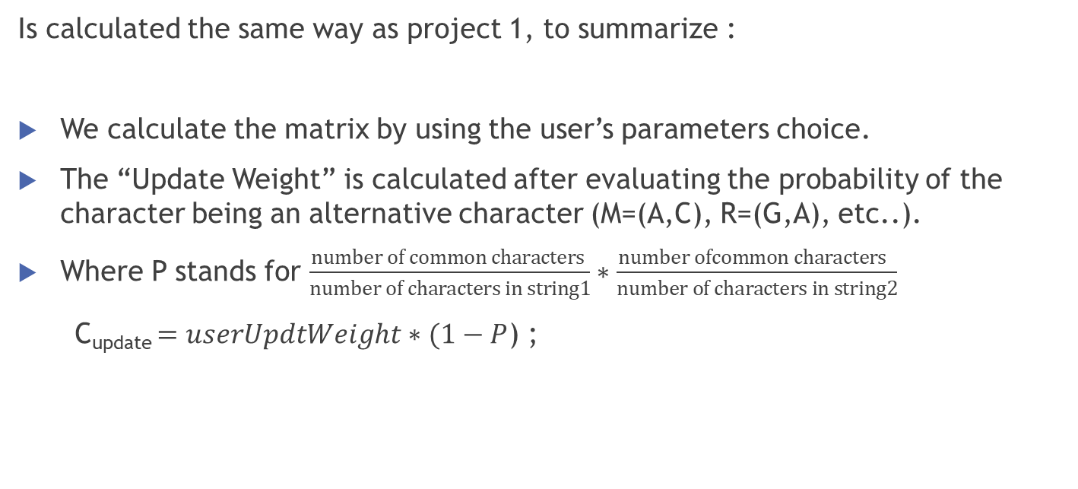
Edit-Distance Similarity:
Is calculated the same way as project 1, to summarize :
We calculate the matrix by using the user’s parameters choice.
The “Update Weight” is calculated after evaluating the probability of the character being an alternative character (M=(A,C), R=(G,A), etc..).
Where P stands for $\frac{number of common characters }{number of characters in string1}∗\frac{number ofcommon characters }{number of characters in string2}$
C_{update} $=userUpdtWeight∗(1−P$) ;

Slide 6
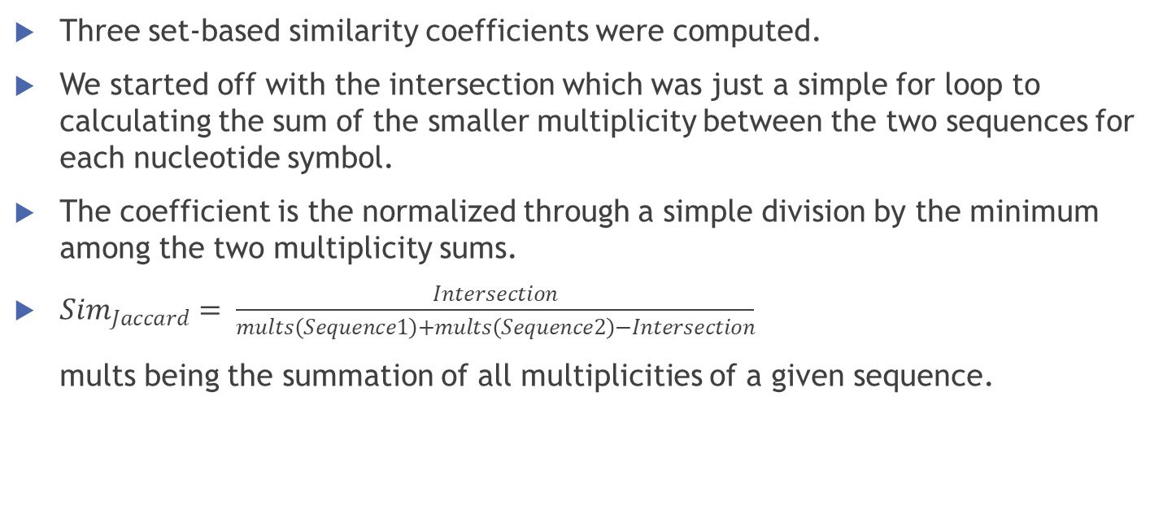
RNA Set-Based Similarities:
Three set-based similarity coefficients were computed.
We started off with the intersection which was just a simple for loop to calculating the sum of the smaller multiplicity between the two sequences for each nucleotide symbol.
The coefficient is the normalized through a simple division by the minimum among the two multiplicity sums.
${Sim}_{Jaccard}= \frac{Intersection}{mults\left(Sequence1\right)+mults\left(Sequence2\right)−Intersection}$
mults being the summation of all multiplicities of a given sequence.
Lastly, we compute the Dice Similarity Measure which simply removes the intersection from the denominator of the previous formula and multiplies the whole thing by 2.

Slide 7
RNA Vector-Based Similarities :
First, we have to Identify the Term Frequency TF (using the same mults method used in set-based) and the Inverse Document Frequency IDF which will be used in all of our models.
To be able to calculate the IDF we calculated the most essential constant in the formula DF. Computing the DF was as simple as checking for every non-zero value in the mults array of each sequence signifying that least one occurrence of the element and incrementing DF by 1 to a maximum of 2 (in the case of comparing 2 sequences).
After managing to compute the weights of each element for both sequences we can now measure the similarity using each model.
Now that we have the vectors (TF x IDF) we used the formulas provided.

Slide 8
The Euclidean and Manhattan measure are a bit similar as they both require us to compute a distance.
The last and slightly more complicated model is the Pearson Correlation Coefficient PCC which required us to get the average values of the weights before using them in the formula’s numerator and denominator which are then computed similarly to the cosine model.

Slide 9
Symbol Weighting :
We then added feature that is allowing the user to fine-tune TF-IDF weights.
The user can change the Edit-Distance parameters ( Update, Insert, and Delete weights).

Slide 10
Processing And Computation Time Evaluation :
We saved a time-stamp using the System.nanoTime() method before and after processing the sequences.
We computed the end-start time.
Next, we converted the calculated time to the user’s preference in time scale.
The same is done for the computation time of the similarity calculations.

Slide 11
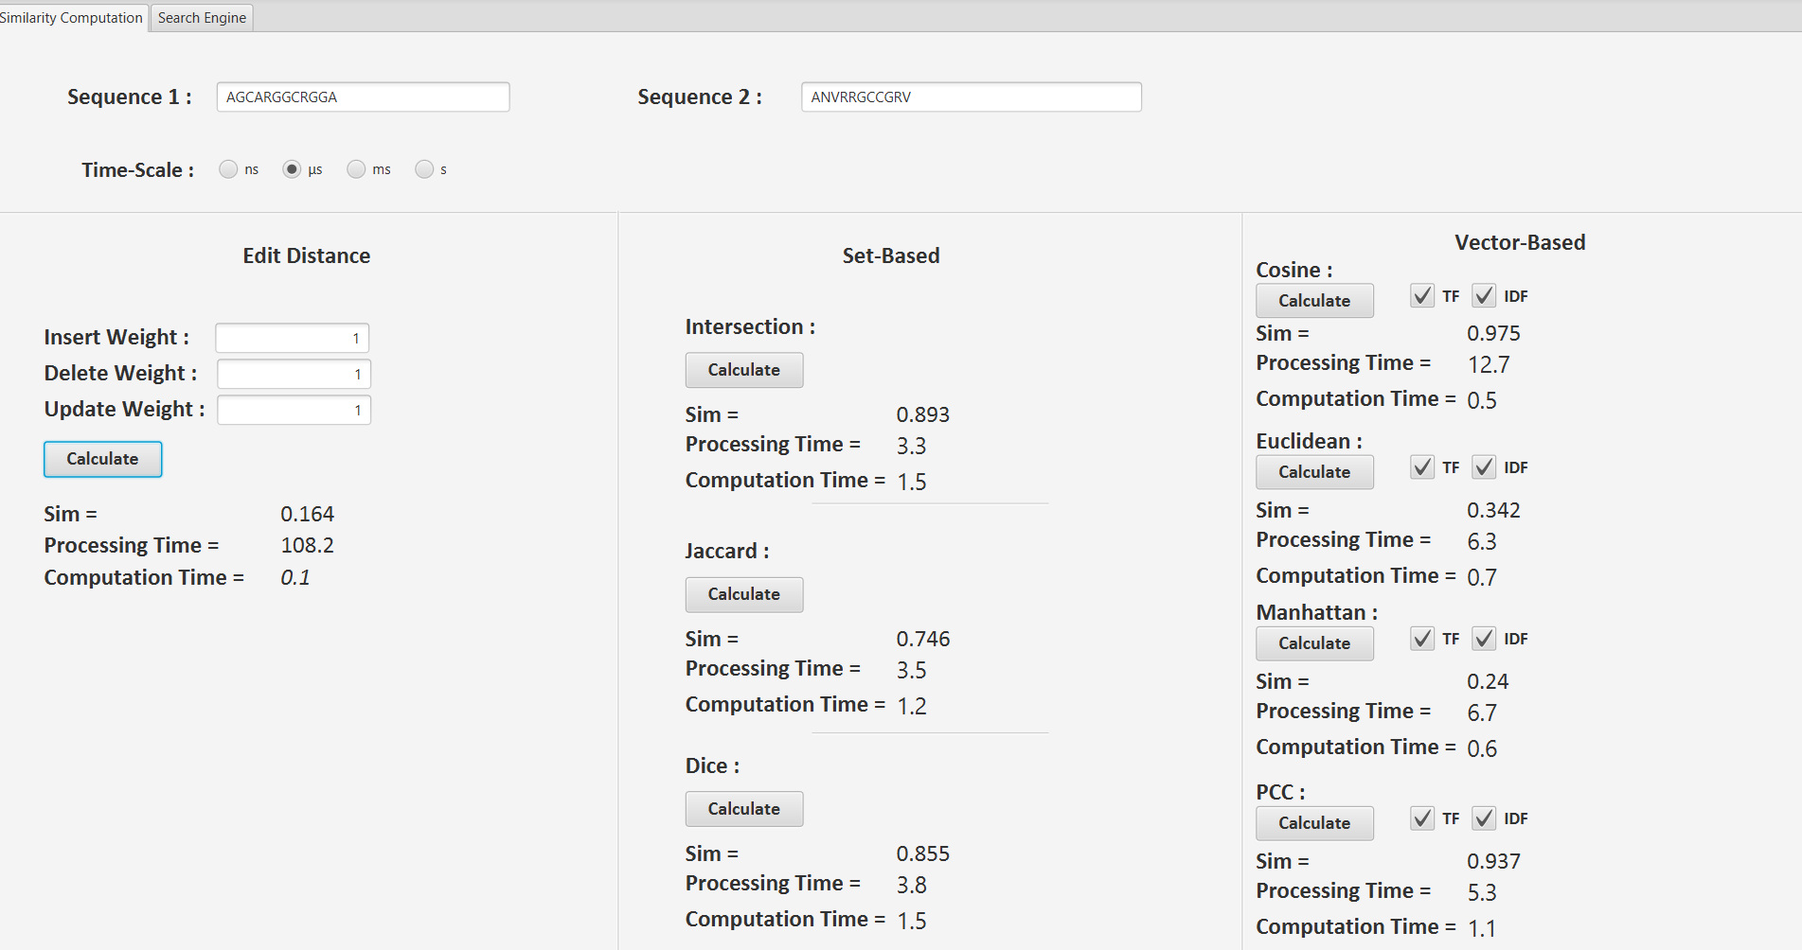
Example Representing Comparing Two Sequences Using The Similarity Measurements

Slide 12
Search Engine :
Initially, we process the input.
We then compare each database entry’s values to the input’s iteratively.
While comparing we check which similarity measures the user wants to use.
Next, we sort the similarities calculations in descending order.
We select the first K received element sequences, excluding the similarities that are below the threshold similarity provided by the user .

Slide 13
Search Engine Evaluation:
After retrieving the results using the similarity measures, we loop through our results calculating the relevant and non-relevant entries.
Using this data we can find out TP, FN, FP and the variation in incrementing the number of results from 0 to K in order to calculate the F value, the mean average precision and to fill in the P-PR graph.
After calling the search method, the above stats will be carried out and the evaluation measures will be filled into static variables which will be retrieved after calling the search method

Slide 14
Evaluating Relevance:
To find our if our input is relevant to any of our retrieved results, we check iteratively if the character in the sequence at any given index is the same in the other sequence at the same index.
This is done by creating a temporary variable for each character in each sequence, which holds the character itself and the character that it could have been (M=(A,C), R=(G,A), etc .. )
Finally, we check if any of the temporary variables’ characters can be found in the other temp variable, otherwise they are considered irrelevant.

Slide 15
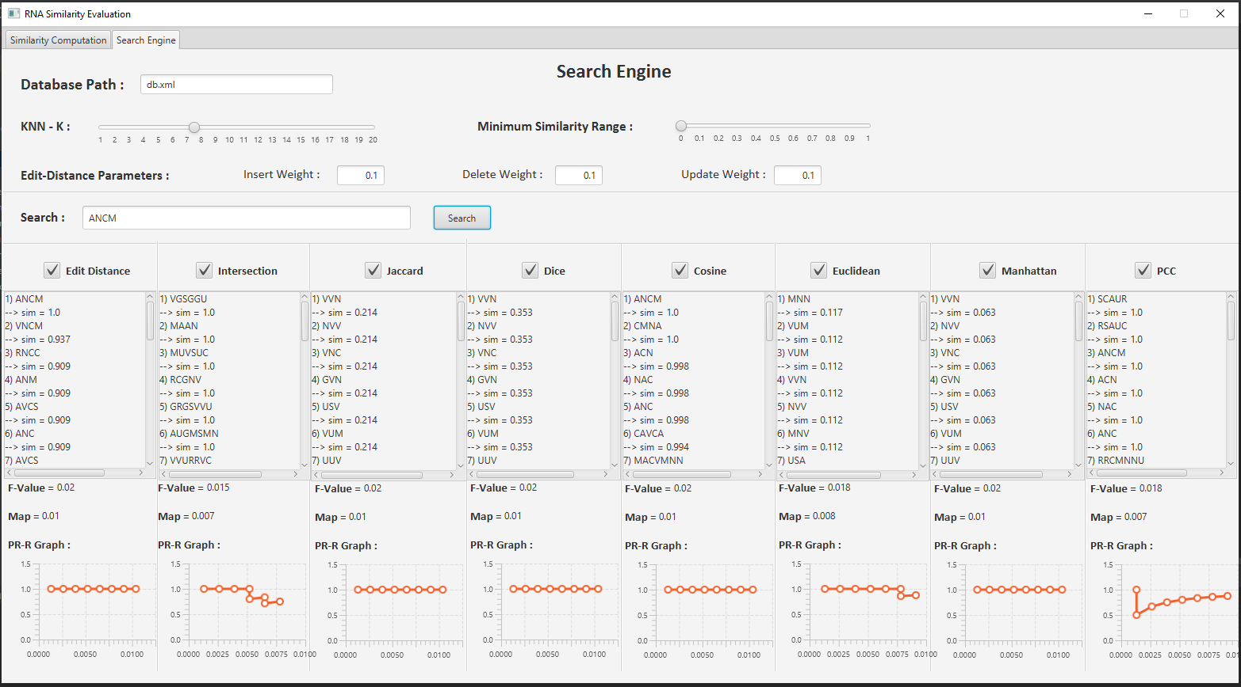
Example Representing Searching For A Sequence In Our Database Using The Similarity Measurement

Slide 16
THANK YOU !

